Slide 1
Overview of Reforms
Consolidating intergovernmental transfers to local government
MINISTRY OF FINANCE, PLANNING AND ECONOMIC DEVELOPMENT
August 2015

Slide 2
Structure of the presentation
Context for reforms
Planned activities in 2015
Objectives of the reforms
Structure of intergovernmental grants
Framework from 2016/17 and additional features
Introducing new allocation formulae
Shifting the focus of accountability

Slide 3
1. Context and rationale
Notes:
This section explains why reforms are being implemented.

Slide 4
Context: Key issues
Since 1997/98, there has been… | Which, altogether contributed towards…
A rise in the number and reliance on conditional grants. A real terms decline in the value of non-wage and development conditional grants. Creation of new districts without reviewing LG structures. | Reduced LG autonomy over spending decisions. Disparities in service delivery levels. Stagnation in the quality of service delivery.
Notes:
Key problems that the reforms aim to address are:
A reduction in the discretion of local governments over spending decisions from increases in conditional grant financing
The reduction of non-wage recurrent and development transfers (in real terms) which has contributed to falling quality of services overall
The inequity of resources between local governments, which has contributed to inequities in service delivery levels.
These are explained graphically in the next three slides.

Slide 5
Context: Discretion and Fragmentation
1997/8
45 Districts
2014/15
133 districts & municipalities
1997/8
10 conditional grants
2014/15
46 conditional grants
Notes:
This slide shows how conditional grants and the number of districts has increased since 1997/98.
The number of higher local governments has increased from 45 (districts) to 133 (districts and municipalities).
The number of conditional grants has increased from 10 to 46 in the same time frame.
Overall, Uganda funds a high proportion of local government spending through conditional grants. That is similar to Tanzania, but very different from countries such as Kenya and South Africa, where unconditional grants make up a higher proportion of local government finances.

Slide 6
Context: Funding and Service Delivery
Quantity
Expansion in Primary Enrolment
Quality
Numeracy and Literacy levels
Funding
Real primary per pupil spending
Notes:
This slide shows trends in the quantity, quality and funding of education spending.
Wage funding has increased in real terms for most sectors.
Non-Wage Recurrent Funding has declined in real, per capita terms.
Development funding declined in real terms for most LGs, except for those benefitting from the PRDP
This has probably contributed to the decline in numeracy and literacy in recent years.

Slide 7
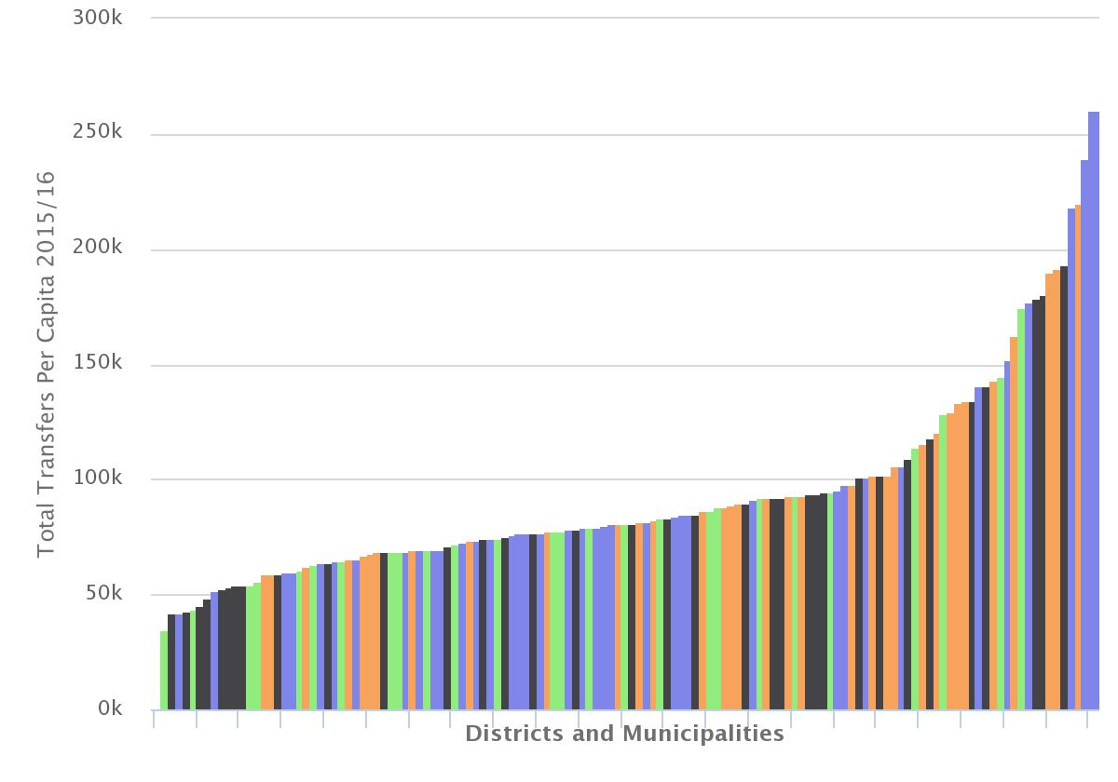
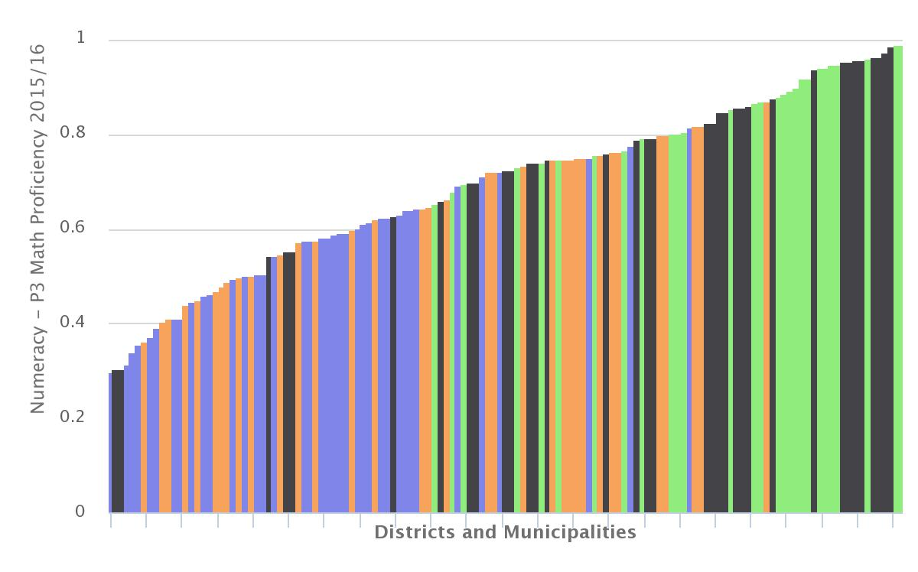
Context: Disparities in Funding and Outcomes
North
East
West
Central
Variations in total per capita transfers across LGs
Variations in numeracy (P3) across LGs
From Shs 34,661 (Wakiso) to 151,932 (Bukwo District) and 260,136 (Soroti MC)
From 29% in Amuria District to 99% in Kalangala District
Notes:
This slide shows the disparities and inequities in transfers and services.
The chart on the left shows that some higher local governments received recurrent transfers (in 2015/16) of more than USh 200,000 per capita. Others received transfers worth less than USh 50,000 per capita. These differences are too big to reflect differences in the need for services.
Equally, there are big differences in services delivery outcomes. Some districts have 30-35 pupils per teacher. Others have over 80 students per teacher. This is likely to contribute to differences in education between districts – the chart on the left shows variations in numeracy between districts, ranging from below 40% to nearly 100%.

Slide 8
2. Objectives and proposed consolidation of grants
Notes:
This section explains what is being done and why.

Slide 9
Four Phases Planned
The first two stages have begun…
1. Interim Consolidation of Local Government Transfers
  Collapsing the number of Sector Conditional Grants to 13 in 2015/16
  Interim Grant Conditions for Sectoral Transfers prepared
  2. Reform to Transfers for 2016/17
  Consolidating and redesigning discretionary transfers
  Revising the allocation formulae and principles for grants to LGs
  Redesign of sector transfers and establishing budgeting requirements
The next phases are starting now…
3. Reforming frameworks for accountability and strengthening incentives
  Strengthening mechanisms for transparent and accountable grant management
  Introducing performance conditionality to lever institutional and service delivery improvements from 17/18 onwards
4. Fiscal Decentralisation Architecture & Share of Transfers (LGFC/ FINMAP)
  Reviewing LG mandates and estimating the cost of adequately financing those mandates relative to the overall budget.
  Reviewing the overall legal and policy framework for local government revenues and expenditures and recommending changes, taking
Notes:
To address the issues raised so far, a number of reforms are being implemented. These reforms can be grouped into four broad stages. The first two stages have already begun.
The main focus of this presentation is the reform to transfers for the 2016/17 budget (number 2). This is to finalise the process of consolidating conditional grants, introducing changes to conditionality, and revising allocation formulae.
In the future further work will be done to review:
Fiscal decentralization architecture: that is a comprehensive look at how local governments are financed. The review is led by the LGFC and will include: (a) what local governments service delivery responsibilities are, (b) the appropriate revenues to be collected or passed on to local governments, (c) the political process for setting the aggregate value of transfers to local governments.
Frameworks for accountability and incentives: that is to ensure that accountability for resources is increased as local governments get more discretion over spending decisions. It is also looking at areas such as ‘results-based financing’ to encourage local governments to deliver better, more efficient services. These frameworks will be introduced from 2017/18 onwards.

Slide 10
Reform Objectives
Overall objectives to guide the process of reforming transfers:
To increase discretion to enable LGs deliver services in line with local needs whilst ensuring that national policies are implemented;
To allow new national policies to be funded via the transfer system, at the same time avoiding future fragmentation of transfers and reduction in discretion;
To shift the focus away fragmented input-based conditions towards accountability for allocation decisions, expenditures and results;
To use the transfer system to provide incentives to improve institutional and service delivery performance; and
To restore adequacy and equity in allocation of funds for infrastructure and service delivery.
Notes:
These are overall objectives guiding the reform process. They are tied to the problems outlined earlier, as well as broader international experiences with fiscal decentralization.

Slide 11
Proposed structure for conditional grants
Recurrent Transfer System |  | Sector | Development Transfer System
Wage | Non Wage | - Health Cond. - | Development
Wage | Non Wage | - Education Cond. - | Development
Wage | Non Wage | Agriculture Cond. - | Development
Wage | Non Wage | - Water & Environment Cond. - | Development
Wage | Non Wage | Works Conditional. - | Development
Wage | Non Wage | Community Development Cond. - | Development
(none) | Non Wage | - Support Services Cond. - | Development
Wage | Non Wage | - District Uncond./Discr. - | Development
Wage | Non Wage | - Urban Uncond./Discr. - | Development
Notes:
This is the new structure of local government grants. There are
6 service delivery sectors,
transitional and support services, and
discretionary grants for urban and rural local governments.
Not all grants need to be used every year:
Black text indicates that there are already grants being provided, and will be integrated into the new structure.
White text indicates grants that are not currently used, but may be created in the future within the new grant structure.

Slide 12
Proposed framework from 2016/17
Six service delivery sectors + support services + discretionary
Recurrent transfer system:
  36 conditional grants consolidated into 11 grants
  Maximum of 1 wage and 1 non-wage conditional grant per sector, with earmarking up to the Vote Function
  Support services incorporate cross-cutting and ad hoc allocations
  Unconditional grants absorb PSM wage and non-wage grants
Development transfer system
  Maximum of 1 development grant earmarked per sector
  1 rural and 1 urban discretionary development equalization grant, replaces equalization grants and harmonizes PRDP, LRDP, USMID, LGMSD
  Transitional services for temporary allocations up to 5% of sector development grant
  1 set of rules and processes for managing all development grants
Notes:
This reiterates the same picture, in a bit more detail.
It also highlights:
Changes to earmarking – that is the rules that say what grants may be spent on. Until now each grant has been earmarked to a specific purpose – e.g. libraries or PAF monitoring. The aim of the reforms is to raise the level of earmarking so that local governments have more discretion over where to allocate resources. Recurrent grants will be earmarked at most to the vote function level (e.g. primary education). Development grants will be earmarked to the sector.
Introduction of a transitional and support services grant – The aim is to incorporate cross-cutting and ad hoc grants while controlling fragmentation, which was an issue in the past. On the recurrent side this will be mainly for cross-cutting grants such as pensions that don’t fit the objectives of either sector or unconditional grants, such as pensions for retired staff. On the development side, this will be for transitional allocations that will be earmarked to a specific purpose (e.g. presidential pledges for school construction) for a temporary period of not more than 3 years, after which the allocation must be absorbed into the sector grant or phased out completely. Transitional development allocations will be limited to no more than 5% of the total development allocation for a sector.
Harmonisation of discretionary development allocations in a district development equalization grant. The aim is to promote equalization through the development grants and give local governments the discretion over where this should be directed. There will be one urban and one district discretionary development equalization grant. This will harmonise the management and allocation of PRDP, LRDP, USMID and LGMSD. Local governments will receive funding from one of these sources only (e.g. only PRDP or only LRDP). This will ensure a fair allocation to less developed districts, no matter which region they are in.

Slide 13
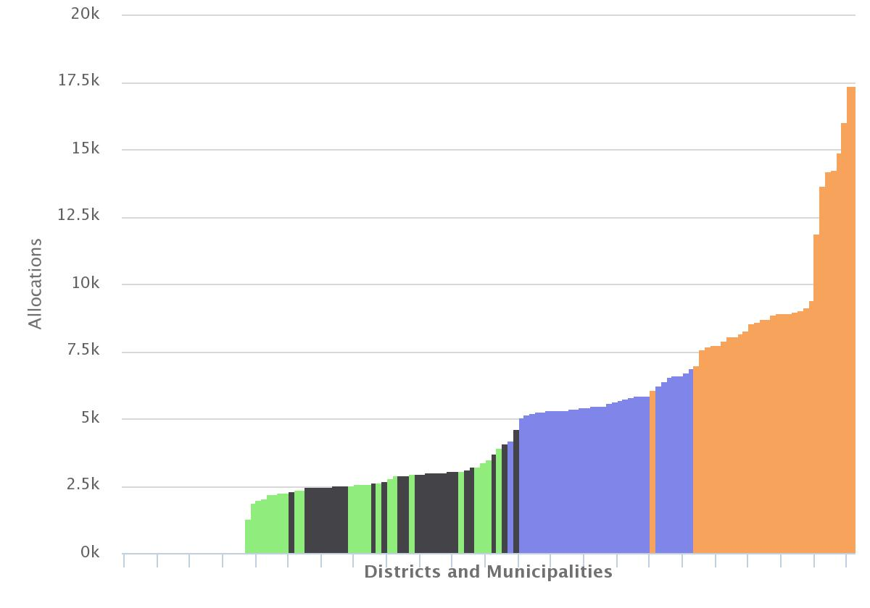
Discretionary Development
Equalisation Grant
Currently a district or municipality may get three or more discretionary grants it can use for development
  e.g. USMID, LGMSD, PRDP, Equalisation Grant
From 2016/16 an LG will only get only one discretionary development equalisation grant, from one window
  The grants would be financed from a merger of the PRDP allocation to sectors and USMID, LGMSD; the LRDP; and the local development grant (LGMSD)
  This would be the vehicle for financing all regional programmes in future.
The grants will have a unified formula
The global allocation to PRDP and LRDP districts would not be reduced
  i.e. overall additionality of the PRDP and LRDP would be maintained.
West
Central
East
North
Notes:
Currently a district or municipality may get three or more discretionary grants it can use for development .e.g. USMID, LGMSD, PRDP
From 2016/17 a LG will get the discretionary development equalisation grant. This will:
be financed from a merger of: the PRDP allocation to sectors; USMID; the LRDP; the local development grant (LGMSD); and equalisation grant. And...
have a unified formula with different weights for urban and rural LGs
Local governments will receive funding from only one window.
For rural local governments the window will be either PRDP/LRDP or Other District. PRDP/LRDP will go to eligible districts only.
For urban local governments the window will be either USMID or non-USMID.
The DDEG will be the vehicle for financing all regional programmes in future and the equalisation grant provided for in the constitution.
The overall additionality of the PRDP and LRDP would be maintained – i.e. the total amount provided to all PRDP eligible districts will not be reduced, though some individual districts may get more or less than they currently do, because of the new formula.

Slide 14
Illustration for non-wage education grants
This slide will change by Sector
2014/15 | 2015/16 | 2016/17
Separate non-wage conditional grants | One non-wage conditional sector grant, earmarked by grant | One non-wage conditional sector grant, at most earmarked to VF
321411 - Primary Education 321419 - Secondary Schools 321432 - Health Training Institutions 321455 - Community Polytechnics 321457 - Technical & Farm Schools 321461 - Technical Institutes 321462 - Primary Teachers' Colleges 321447 - School Inspection Grant | 070000-321466 non-wage cond. grant o/w Primary Education o/w Secondary Schools o/w Health Training Institutions o/w Community Polytechnics o/w Technical & Farm Schools o/w Technical Institutes o/w Primary Teachers' Colleges o/w School Inspection Grant | Either: 070000-321466 non-wage cond. grant Or, at most: 070000-321466 non-wage cond. grant o/w 0781 Pre-Primary and Primary o/w 0782 Secondary Education o/w 0783 Skills Development o/w 0784 Inspection and Monitoring
Transition from individual grants to new framework, illustrated with Education sector
Notes:
This shows how earmarking will transition from 2014/15 to 2016/17.
2014/15 individual grants with separate conditions and reporting
2015/16 consolidated grants maintaining separate conditions and reporting
2016/17 consolidated grants raising the level of earmarking and harmonizing reporting

Slide 15
Additional features
Flexibility to reallocate:
  Not between sector service delivery grants.
  Up to 10% between vote functions within a sector service delivery grant.
  From recurrent to development to promote equalisation
New policies will be funded within this framework:
  Temporary, time-bound earmarking to ensure the new policy is financed;
  After the time period is over, the allocation becomes part of the sector grant.
Performance conditions to improve service delivery
  results-based financing of service delivery units; or
  performance-based funding to encourage adherence to LG processes.
Straight through processing implemented consistently across sectors
Notes:
Reforms will also have a number of additional features:
There will be more flexibility to reallocate during budgeting, within the sector budget requirements that are detailed in a Grant and Budget Information Paper
No reallocation between sectors (e.g. education to health)
Up to 10% of one vote function to another (e.g. primary to secondary education)
From recurrent allocations to development allocations (e.g. wage/non-wage to development)
New and temporary policies can be earmarked to a specific purpose under the Transitional and Support Services grant. These will need to be absorbed in the sector grant or phased out completely after 3 years.
Part of the allocation in some sectors may be tied to performance:
Results-based financing (for sectors) to pay service delivery units (e.g. health centres) for delivering services at the required quality. This is relatively new in Uganda.
Performance-based financing (for discretionary grants) to pay LGs that meet institutional performance criteria (e.g. producing financial statements on time). This is already in place under USMID and LGMSD grants.
Straight through processing will be implemented consistently across all sectors. Where appropriate, grants for an LLG or service delivery unit will be paid straight to the LLG or service delivery unit. This will be done by MOFPED on the basis of the budget prepared and submitted by HLGs.

Slide 16
New allocation formula
Consolidation of grants requires new formulae.
New formulae are underpinned by common principles:
  Formula should be closely linked to the purpose of the grant
  Formula should be simple, equitable and not undermine incentives to promote service delivery
A common approach will be used for all formulae:
  One formula for all grants within a sector, with min/max allocations for wage, non-wage and development
  Two formulae for urban/district discretionary (recurrent, development)
Data and formulae should be easy for LGs to understand and access
Notes:
Consolidating grants means that new allocation formulae are needed. These will also be an opportunity to address inequities in resource allocation over the medium term.
Formula design will depend on the overall grant purpose:
Sector grants allocated based on need/cost of services
Support services will have ad hoc allocations/formulae
Discretionary development grant will use equalizing formula.
Guiding principles are:
Formulae should be simple and transparent:
No more than 5 variables
Data and formulae should be easy for LGs to understand and access
Formulae should be equitable, but ‘closed ended’
Match resources to target population (e.g. school age population, rather than number of existing number of pupils)
Reflect major differences in ‘need’ and costs (e.g. poorer areas may need more, or larger districts may face higher costs of service provision)
Must not require more resources than are available (closed-ended)
To promote the right incentives, variables used in the formulae should be:
‘exogenous’ to influence from LGs (i.e. don’t use data produced by LGs)
stable, measured regularly and available for all LGs
reflect objective factors, not local policy decisions
be from official sources only (e.g. UBOS not UNDP)
The formulae will follow a common approach:
Sector conditional grants: One allocation formula will be used to allocate resources to wage, non-wage recurrent and development grants in a sector. Budget and Grant Information Papers will state in the sector budget requirements what the maximum or minimum share will be for wage, non-wage recurrent or development allocations.
Unconditional and discretionary grants: will have an allocation formulae for urban recurrent, urban development, rural recurrent and rural development.
Transitional and support services: will have formulae or ad hoc allocations for each item (e.g. pensions will have a different allocation to urban water operation and maintenance grants).
Data and formulae will be made available to the public on the Online Transfer Information Management System (OTMIS). This will include information on the variables used for allocation and IPFs for local governments.

Slide 17
Phasing in new formulae
Formulae will be phased in gradually to minimize the number of LGs that get less than they do in 2015/16 (“hold harmless” approach).
The pace of introduction will be determined as follows:
  Estimate of fiscal space to increase transfers
  Calculate the share of each LG under the new formula
  Gradually increase allocations for districts below target level
  Phase in changes more rapidly for development grants than for recurrent
These changes are reflected in the MTEF.
Notes:
Formulae are redistributive so cannot be phased in immediately. To improve equity some local governments will get more than they currently do, others less. Therefore, they will be phased in gradually from 2016/17. The more resources made available in the MTEF the faster this phase in period will be.
A schedule will set out how the formulae will be phased in over time. The share of each local government will be calculated under the new formulae. Those receiving less will receive incrementally more resources each year until they reach the target level. This can be done more quickly for development grants than for recurrent grants, because capital investments are not funding services that must be provided year on year, in the way that wages and non-wage recurrent grants are. In other words, it is easier to slow the pace of school construction than to reduce the number of teachers.

Slide 18

Focus on Accountability
Reliable, comparative and readily interpretable information on allocations, expenditures and results for local government needs available to local and central government actors, civil society and the public.
Robust processes of monitoring, provision of feedback and follow up need to be in place and compliance enforced.
Notes:
Greater discretion over budget decisions requires a greater level of accountability for performance. There will be a shift from earmarking to sector budget requirements linked to basic sector policies and processes. (There is a separate presentation on the Sector Budget Requirements)
Central government will build on existing tools such as the budget website and call centre to improve the monitoring of local government performance, increase the opportunities for feedback from inside and outside the government, and track follow-up actions. This will become a core part of the evaluation of Accounting Officers, whose contract may not be renewed if compliance with the new requirements is poor.
The Uganda Budget Website (www.budget.go.ug) will be a one-stop-shop for:
Information on allocation formulae (e.g. IPFs and allocation formulae)
Sector budgetary and key performance information (e.g. data on educational outcomes, and performance reports)
Central and Local Government and NGO monitoring reports (institutions will be able to upload these themselves)
Posting feedback on monitoring specific projects and service providers (this may be done by government staff, but also external stakeholders)
Posting information about how the government is following-up on feedback.

Slide 19
Thank You
Any Questions?

