Slide 1
CONSULTATIVE WORKSHOPS ON LOCAL GOVERNMENT BUDGET FRAMEWORK PAPER
PPDA Presentation on Public Procurement
Challenges in Procurement within Local Governments and way forward
September-October 2018

Slide 2
Presentation outline
Statutory Objectives of the PPDA
Previous recommendations and progress on implementation
Overall performance of LGs in FY16/17
Key Implementation Challenges to Service Delivery in LGs
Research findings
Recent Guidelines
Electronic Government Procurement (EGP)
Way forward

Slide 3
Statutory Objectives of the PPDA
The objectives of PPDA are provided in Section 6 of the PPDA Act, which are:
Ensure the application of fair, competitive, transparent, non-discriminatory and value for money procurement and disposal standards and practices;
Harmonize the procurement and disposal policies, systems and practices of the central government, local governments and statutory bodies;
Set standards for the public procurement and disposal;
Monitor compliance of procuring and disposing entities;
Build procurement and disposal capacity in Uganda.
The detailed functions and powers of PPDA are contained in Sections 7 and 8 of the PPDA Act, 2003.

Slide 4
Previous recommendations and progress on implementation
Recommendations | Status
PPDA to ensure that all govt's obsolete assets are dispose of | The Authority has identified Entities with un disposed assets during audits and recommended to the affected Entities to dispose. The Authority is enforcing disposal planning. A study/research was conducted on failure by Entities to dispose assets and its recommendations are being implemented.
Status on the amendments of the LG (PPDA) Regulations | The second draft of amendments is before cabinet
Delays in the procurement processes caused by the PPDA Law | Amendments are on going to remove areas that causes delays in the process. EGP to improve efficiency once it is rolled out. PPDA is enforcing procurement planning and adherence to plans. Capacity building of key players to improve efficiency.

Slide 5
Previous recommendations and progress on implementation Cont’d
Recommendations | Status
Delays in the procurement processes caused by the PPDA Law | Amendments are on going to remove areas that causes delays in the process. EGP to improve efficiency once it is rolled out. PPDA is enforcing procurement planning and adherence to plans. Capacity building of key players to improve efficiency.
Procurements/projects awarded by Central Government Agencies and why these procurements have to be handled at the centre. | This is a policy matter and based on loan agreements and the Authority will engage line ministries on how best Local Govts can be involved in procurements
Need to improve the PDUs budgets to cater for its operational expenses like printing services, allowances for CCs and Evaluation Committees. | Audit reports have been highlighting this challenge of facilitation, these reports are copied to the PS/ST and Accountant General. Entities are advised to utilize monies obtained from sale of bids to run some of PDU activities as required in the PPDA Act and Regulations

Slide 6
Previous recommendations and progress on implementation Cont’d
Recommendations | Status
LGs should encourage collaboration among technical and political leaders in implementation of Government programmes within the law. | Political leaders are only required to approve the procurement plans and monitor implementation as provided in the law.

Slide 7
Overall performance of LGs in FY16/17

Slide 8
Overall Performance of Entities by Value

Slide 9
Overall Performance of Entities by Number

Slide 10
Key Implementation Challenges to Service Delivery in LGs
Poor procurement plan implementation due to :
Budget constraints
Over planning
Poor plan management e.g. late commencement of procurements, procurement outside plan etc
Capacity issues i.e. Understaffing in many PDUs
Collusion among bidders and between LG officials that leads to financial loss, low bidder participation, no VFM etc

Slide 11
Research findings
Low Bidder Participation
PPDA conducted a survey to establish the causes of low levels of competition for government contracts
The Authority observed that there are low levels of competition for government contracts with an average of only two bids was received per procurement
This is contrary to PPDA’s strategic plan objective to increase competition that targets the average of 5 number of bids received per procurement by the end of financial year 2018/19.

Slide 12
Causes of low bidder participation
The study findings revealed that 67% of the respondents reported more than one barrier
54% cited delays in payments,
53% cited corruption,
46% reported high cost of bidding,
41% reported ambiguous/ unclear specifications,
36% reported inadequate knowledge of the available opportunities,
35% reported lack of finances and 14% reported lack of technical capacity to meet procurement demands.

Slide 13
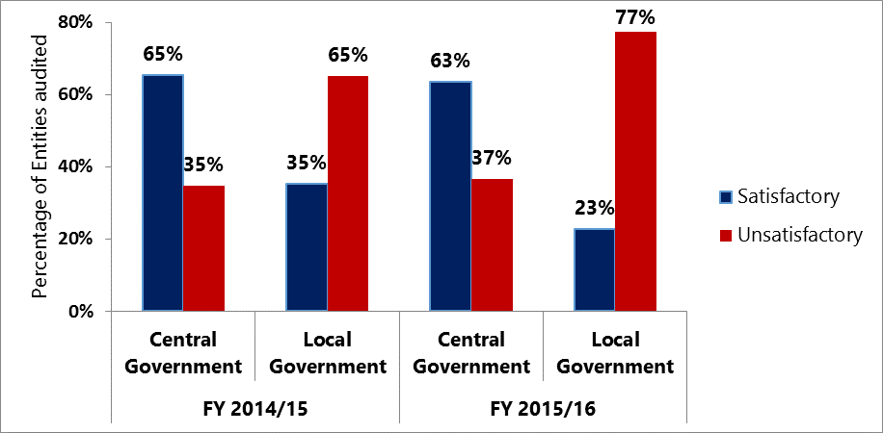
Figure for low bidder participation
Source: procurement audit reports FY 2015/16- FY 2016/17

Slide 14
Research findings Cont’d
Force Account
Challenges | PPDA Recommendations
LGs do not have personnel and equipment to implement force account | .Get equipment or personnel from another PDE .Hire equipment using rates provided by the ministry of works. Supervise works using a qualified supervisor
Projects under force account are more expensive than contracting | The PDE shall determine that the direct, indirect and overhead costs to be incurred are less than would be incurred if the assignment was executed by a contractor. .PPDA to conduct an audit on force account projects and come up with new innovations.

Slide 15
Research findings Cont’d
Force Account
Challenges | PPDA Recommendations
Accountability challenges under force account | Do not transfer the force account budget to the engineer. Requisitions for any requirements shall be made and accounted for. Record keeping shall be key All procurements to be handled by the PDU All payments to be made by finance/Accounts Maintain and manage records and apply proper accounting standards in accordance with the Public Finance Management Act. Ensure that works are executed in accordance with the applicable technical standards

Slide 16
Recent Guidelines
Preference and reservation schemes guideline to promote local content;
Margin of preference 7% for works & services,15% for goods
30% to be Sub contracted to the local firm
Promotion and use of local materials for manufacturing industries

Slide 17
Electronic Government Procurement (EGP)
E-GP is the use of Information and Communications Technologies in conducting activities of Government Procurement Process Cycle for the acquisition of goods, works, and services
The eGP is envisaged to address the same challenges that compromise the achievement of value for money and service delivery through procurement. These include inefficiencies such as delays in the acquisition process, poor budget absorption, fraudulent practices, integrity, transparency and accountability issues; low bidder participation among others

Slide 18
eGP to improve service delivery
Common Database of procurements
Enhancing decision making by providing meaningful and comprehensive procurement information
Improve financial planning and budgeting
Enhanced monitoring of procurement by PPDA
Centralised record keeping and management
Introduction
Efficiency and cost reduction in processes
Procurement
Transparency and improved accountability of practices & Procedures
Increased Competition
Better Quality of service
Cost Reduction in both the processes and the services
History
Enhance citizen’s and businesses’ confidence in govt procurement processes and utilisation of public funds

Slide 19
Way forward
The Local Government amended Regulations are being revised by PPDA and MOLG and will be issued as soon as they are ready
LGs need to play their part to increase efficiency in the procurement process. Plan properly, commence on procurements early, follow evaluation criteria, conduct thorough market assessment etc.
Manage contracts effectively to ensure that implementation is done in time and to the required standards.

Slide 20
Thank You!
Head Office:
UEDCL Towers, Plot 37 Nakasero Road
P.O. Box 3925, Kampala Uganda
Tel: 256 414 311 100
Fax: 256 414 344 858 or 256 414 250 031
Web: www.ppda.go.ug
Email: info@ppda.go.ug
Connect: www.facebook.com/ppdauganda

