Slide 1
REGIONAL LOCAL GOVERNMENT BUDGET CONFERENCES
FISCAL RISK MANAGEMENT PERSPECTIVES IN THE GOU BUDGETING PROCESS
BY
OFFICE OF INTERNAL AUDITOR GENERAL(OIAG)

Slide 2
Discussion Plan
Introduction
GoU Fiscal Risk Management Legal Framework
Budget Formulation – BFP process and roles and responsibilities for fiscal risk management
Action Status
Fiscal Risk Management- Service Delivery Outcomes

Slide 3
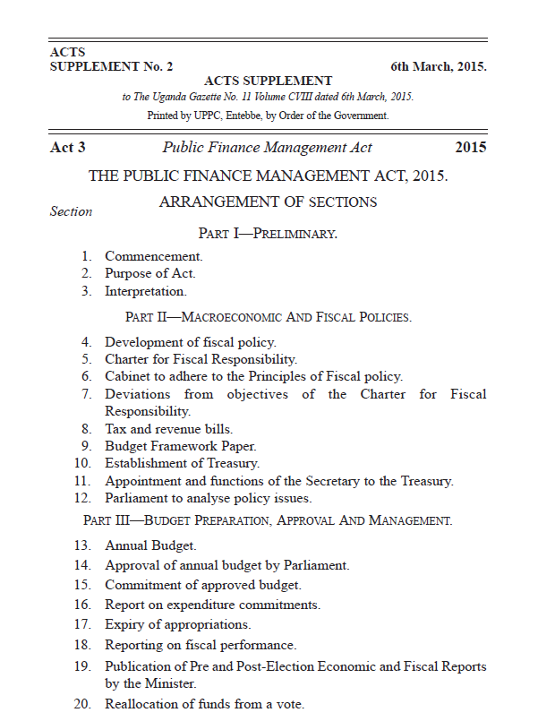
GoU Fiscal Risk Management Legal Framework
Ministers – As per Section 4(3) of the PFMA, the Minister is responsible for setting measurable fiscal objectives for the fiscal principles as outlined in Section 4(2) of the PFMA. One of the key principles is management of fiscal risks in a prudent manner - subsection 4(2e).
Accounting Officers – Section 45(2) of the PFMA requires that: “In the exercise of the duties under this Act, an Accounting Officer shall, in respect of all resources and transactions of a vote, put in place effective systems of risk management, internal control and internal audit.”
Internal Auditors – Section 48(2b) of the PFMA requires that: “An internal auditor shall - evaluate the effectiveness and contribute to the improvement of risk management processes of a vote.”
Section 48(3); “An internal auditor shall prepare an annual work-plan of the activities to be carried to be carried performed in a financial year which shall be determined by the fiscal risk of a vote”.
Audit Committee – Section 49(5d) of the PFMA requires that: “An audit committee shall - facilitate risk assessment to determine the amount of risk exposure of the assets of the vote and the possibility of loss that may occur, with a view to mitigating risks.”

Slide 4
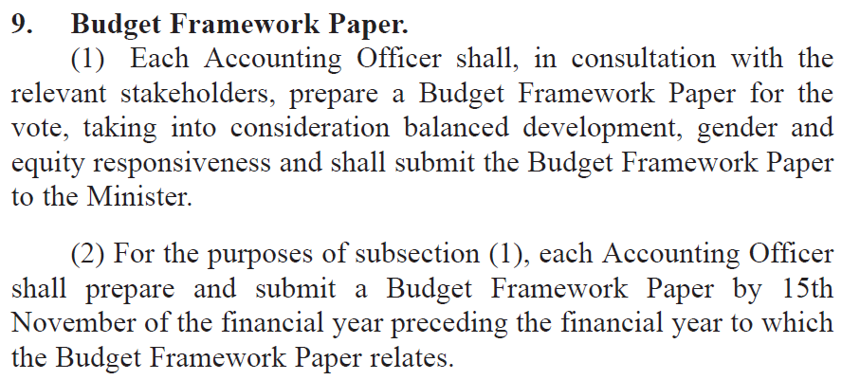
BFP- Role of Accounting Officers

Slide 5
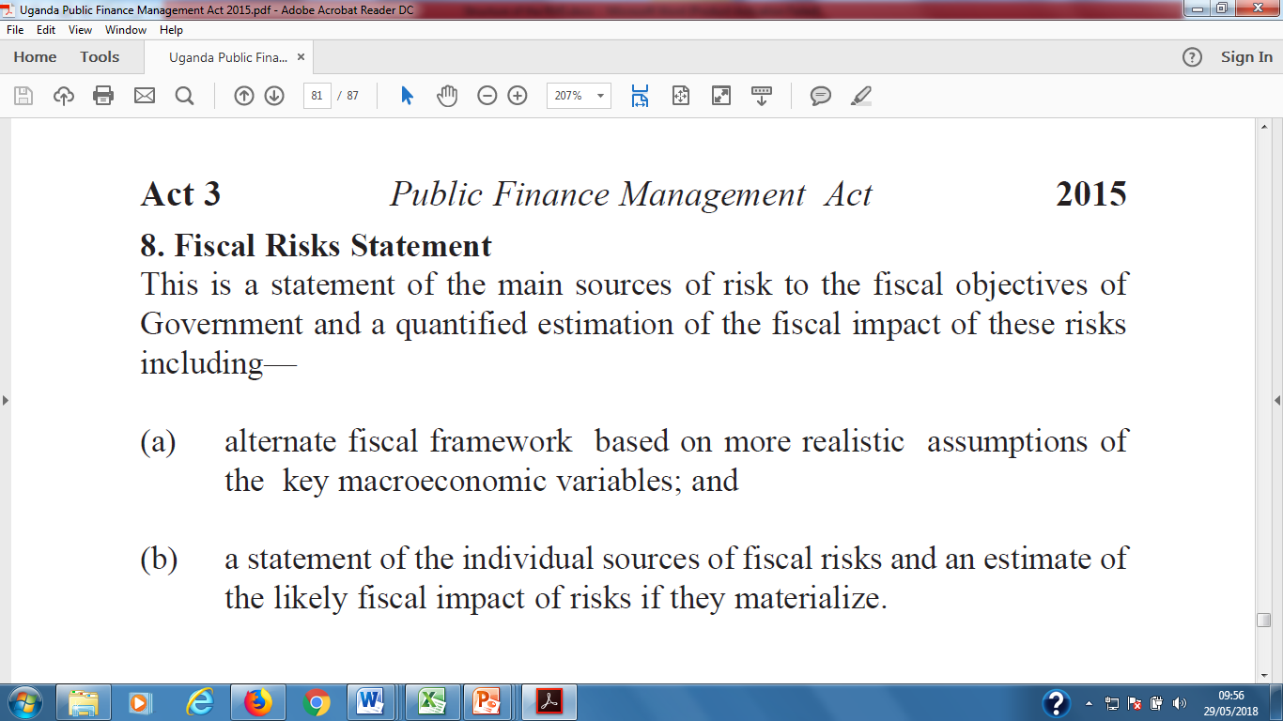
Budget Framework Paper Format Schedule 3 of the PFMA-2015

Slide 6
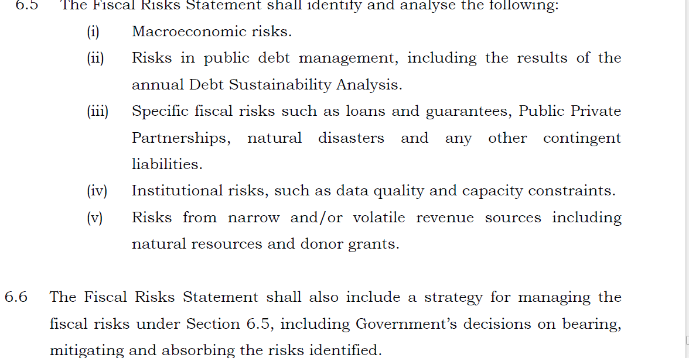
Sources of Fiscal Risks- CFR

Slide 7
Fiscal Risk Management Strategy-Process
Risk Assessment
Risk Mitigation
Risk Monitoring
Risk Reporting
Risk identification
Strategy Context
Risk Appetite Statement

Slide 8
Embedding FRM- Getting Started
We live in an ever changing world where we are forced to deal with uncertainty every day. But how an organisation tackles that uncertainty can be a key predictor of its success

Slide 9
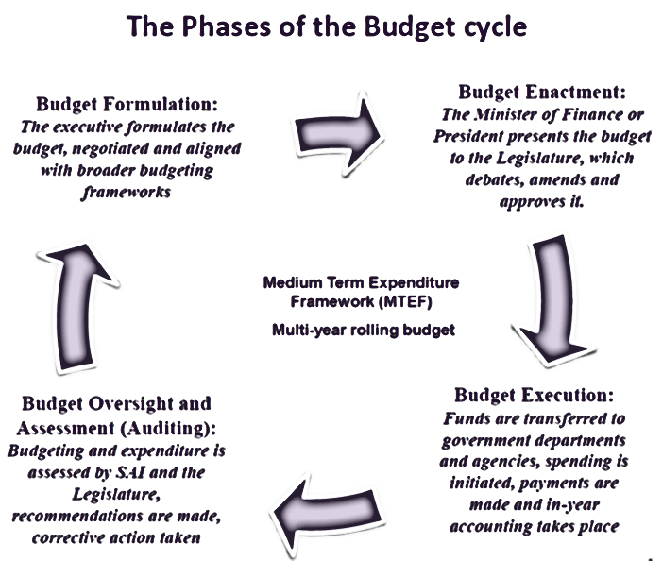
GoU- Budget Cycle

Slide 10
Contd…
No | Area | Actions | status | Responsibility
1 | Legal | PFMA -2015 | Done | Minister for Finance Accounting Officers Internal Auditors Audit committees Accountant General Internal Auditor General
2 | Institutional | MoFPED through the Office of Internal Auditor General is playing the overall facilitative, monitoring and coordinating role in the implementation of the strategy- | Done | Secretary to the Treasury Internal Auditor General Commissioner Forensics and Risk Advisory (C/FRA)

Slide 11
Contd..
No | Area | Actions | status | Responsibility
3 | Risk Management Strategy | Situational analysis and Risk Management Strategy Development | Completed | Secretary to the Treasury Accounting Officers Internal Audit
4 | Awareness and Stakeholder engagement | Embed risk management at National Planning and into each vote / entity’s strategy development and planning process. Hold discussions with NPA, participate in Budget formulation process, include key risks in sector BFPs and Entity MPS | Ongoing | Secretary to Treasury(BCC) Accounting Officers

Slide 12
Contd..
No | Area | Actions | status | Responsibility
5 | Risk Management tools | Risk Management manual | Not done | Internal Auditor General C/FRA

Slide 13
RM- Service Delivery outcomes
More sustainable and reliable risk financing options for projects, recurrent expenditure including Disaster risk financing
Risk informed decisions to guide policy formulation and resource allocation
Enhanced innovation;
Reduced wastage of public resources
Prevention of fraud and corruption;
Effective public investment management through more efficient use of resources(Better value for money)
Better outputs and outcomes through improved project and programme management.

Slide 14
End
Thank you

